Slide 1
Unit-1
Python Basics
Python Objects
Standard Types
Other Built-in Types
Internal Types
Standard Type Operators
Standard Type Built-in Functions
Categorizing the Standard Types

Slide 2
Unsupported Types
Numbers - Introduction to Numbers
Integers, Floating Point Real Numbers
Complex Numbers
Operators
Built-in Functions
Related Modules
Sequences - Strings, Lists and Tuples,
Mapping and Set Types

Slide 3
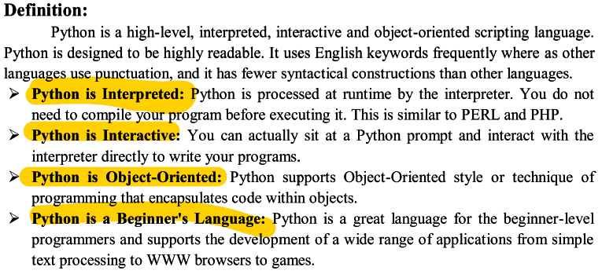
Python

Slide 4
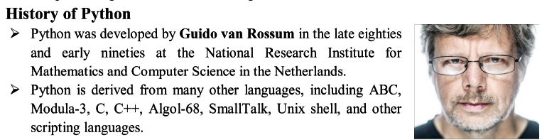
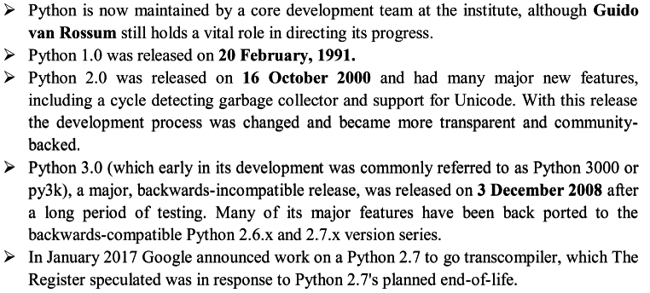

Slide 5
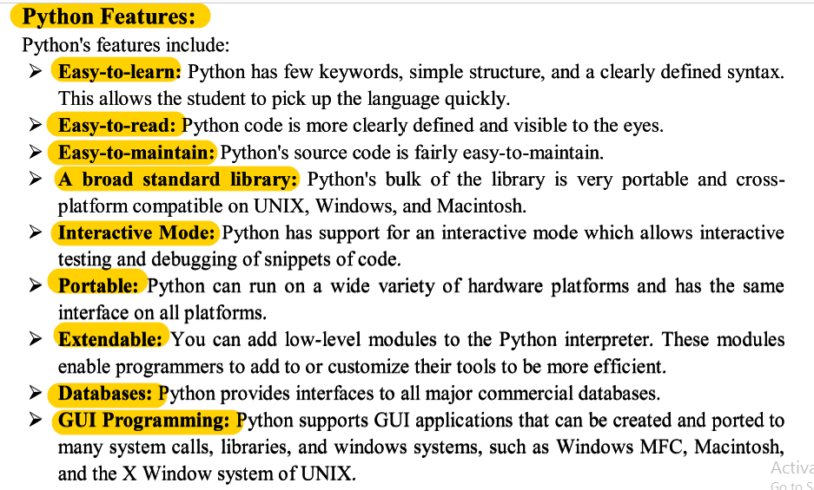

Slide 6


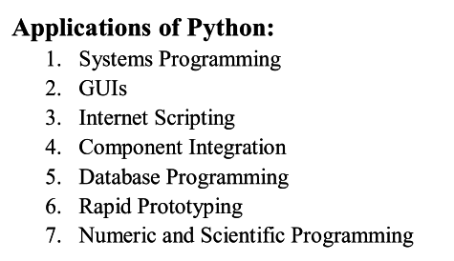
Need for python:
Portable
Open Source Soft ware

Slide 7
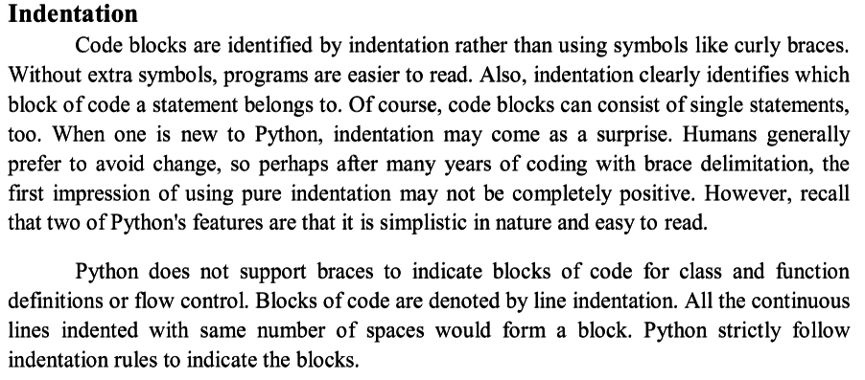

Slide 8
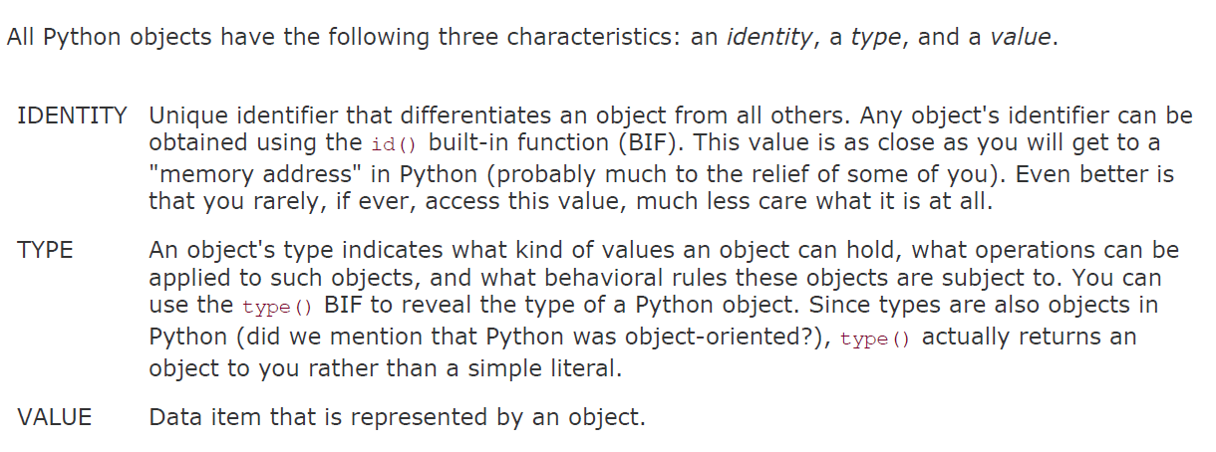
Id() method return the address of the object
Type() method return the type of the object
Value return the data in the object

Slide 9
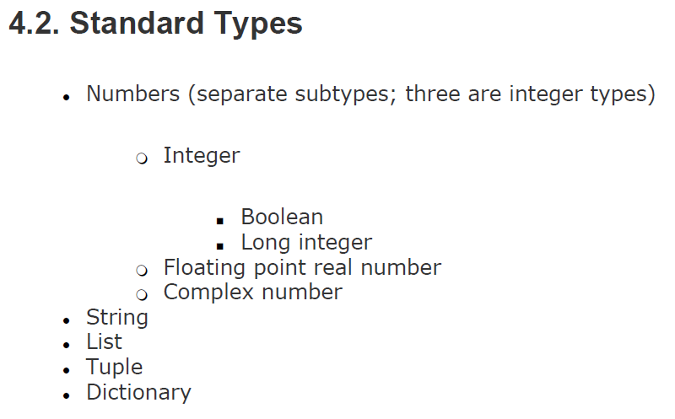

Slide 10
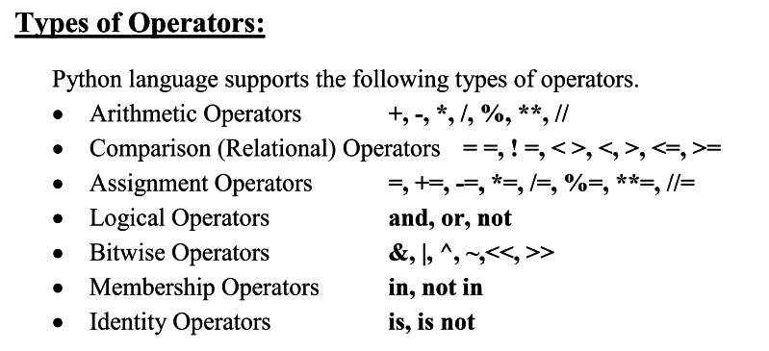

Slide 11
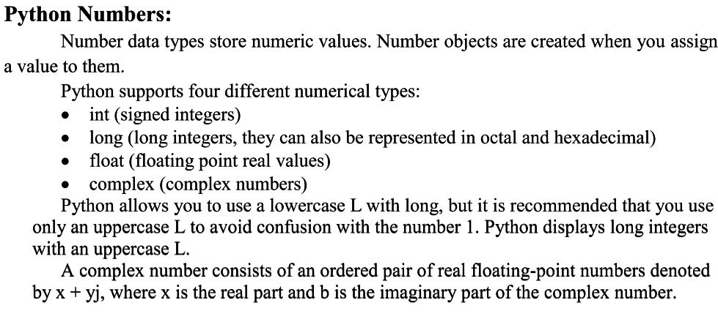

Slide 12
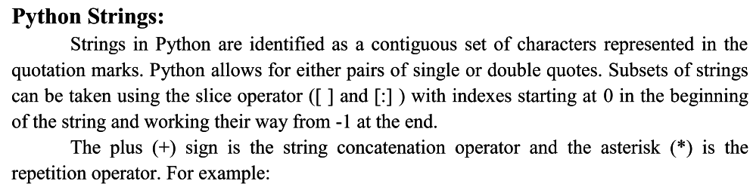

Slide 13
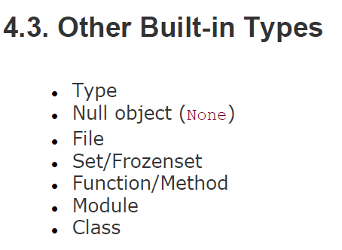

Slide 14
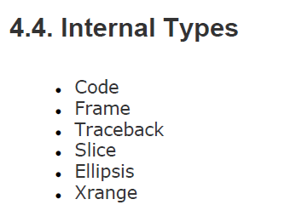

Slide 15
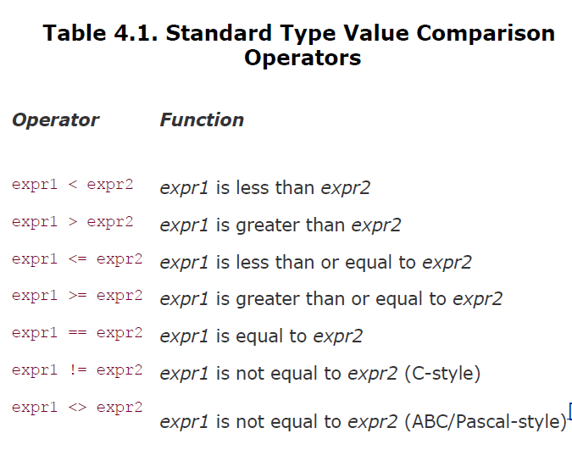

Slide 16
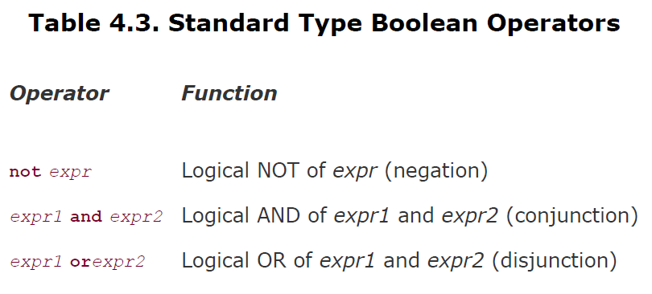

Slide 17
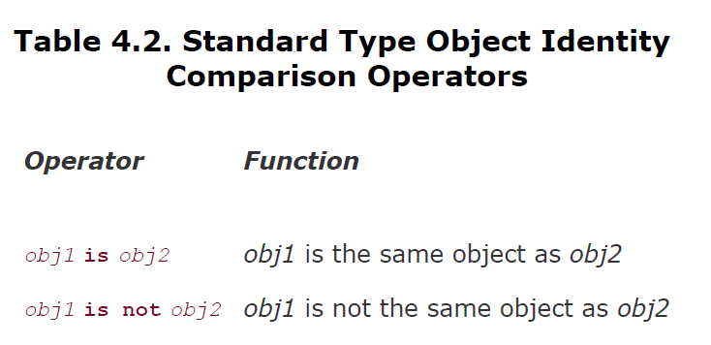

Slide 18
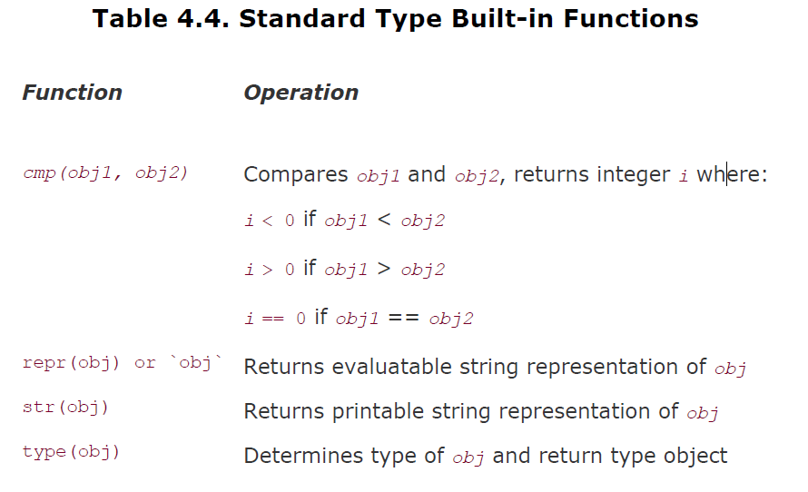

Slide 19
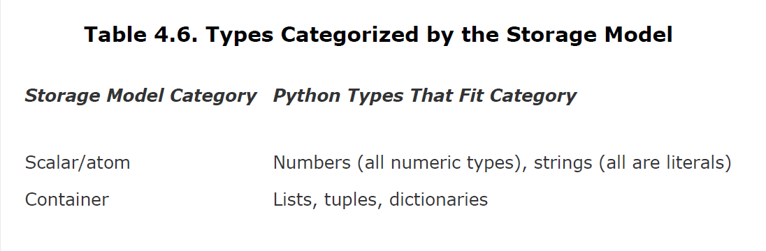

Slide 20
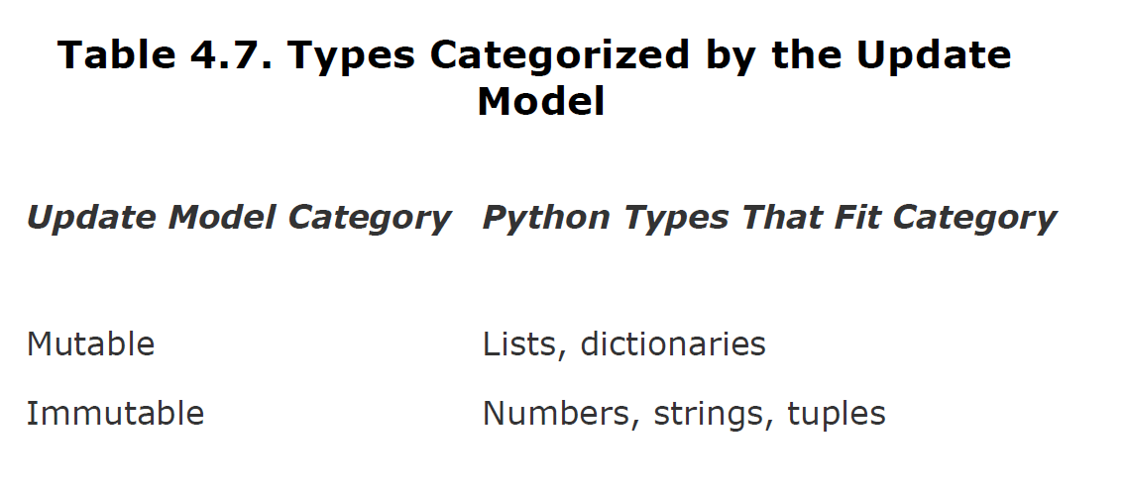

Slide 21
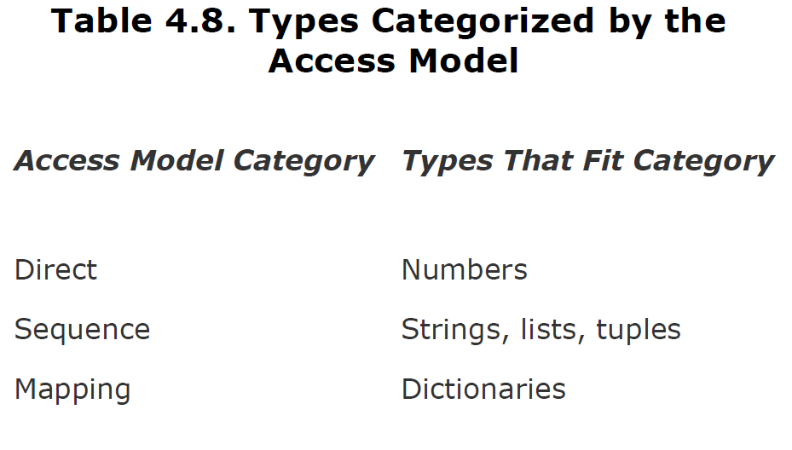

Slide 22
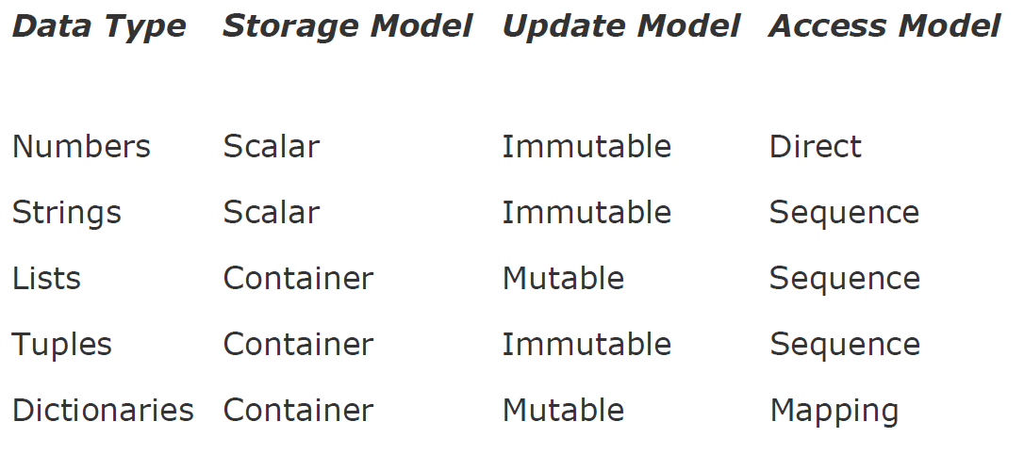

Slide 23
Unsupported Types
list of types that are not supported by Python.
char or byte
int versus short versus long
float versus double

Slide 24
Numbers - Introduction to Numbers Integers, Floating Point Real Numbers ,Complex Numbers

Slide 25
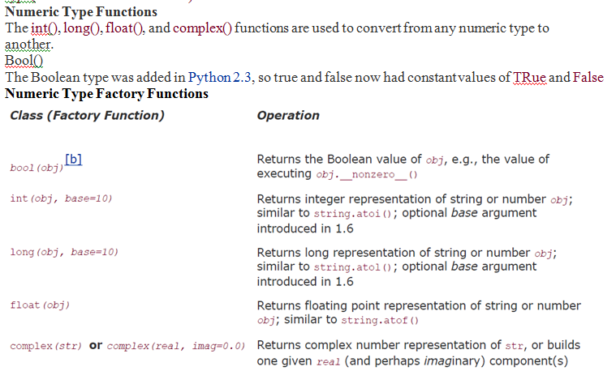

Slide 26
Examples on Numbers::
Example for integers:
a=90;
b=2;
C=a>>2;
Print(c)
Print(type(c))
***
Example double numbers:
a=9.0;
B=4.7
C=a/b
Print(c)
Print(type(c))
**
Example1 on Complex number:
a=7+8j
Print(a)
Print(type(a))
Example2 on Complex number:
a=complex("3+2j")
print (a)
print("a is",a)

Slide 28
Standard Type Functions
cmp(-6, 2)
str(0xFF)
str(55.3e2)
type(0xFF)
type(98765432109876543210L)

Slide 29
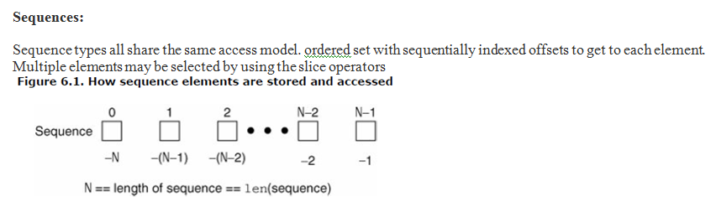

Slide 33
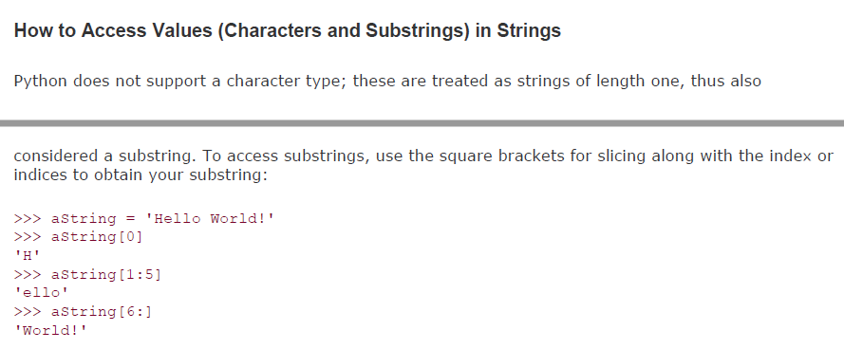
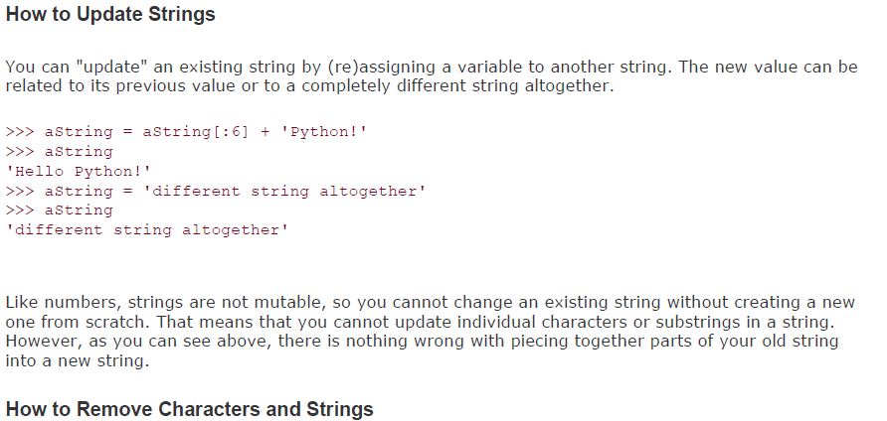

Slide 34
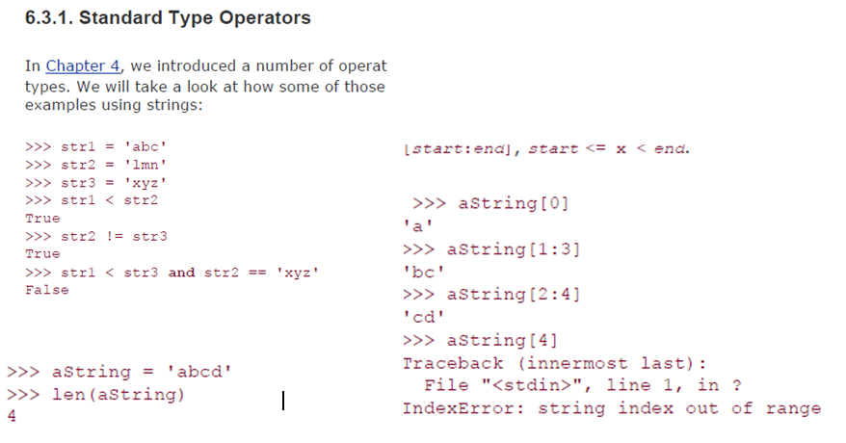

Slide 35
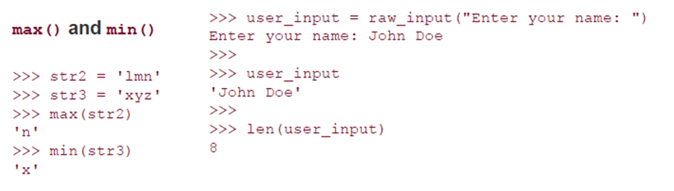

Slide 37
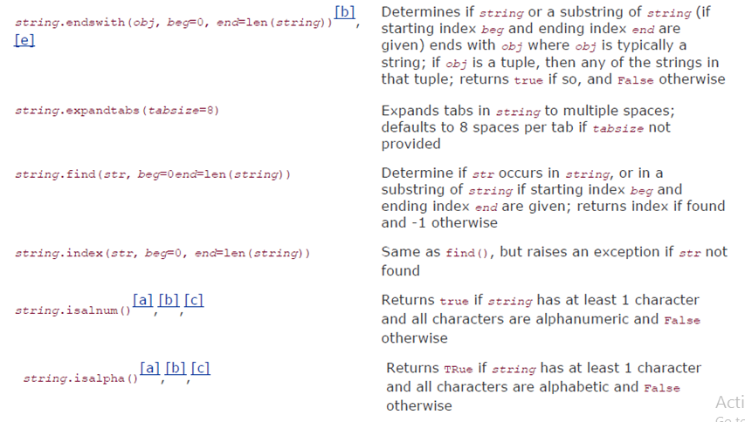
Built in Methods on Strings cont..

Slide 38
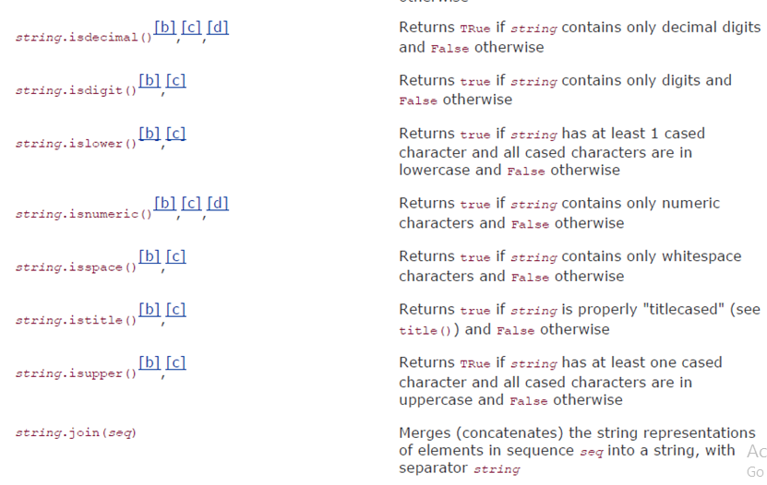
Built in Methods on Strings cont..

Slide 39
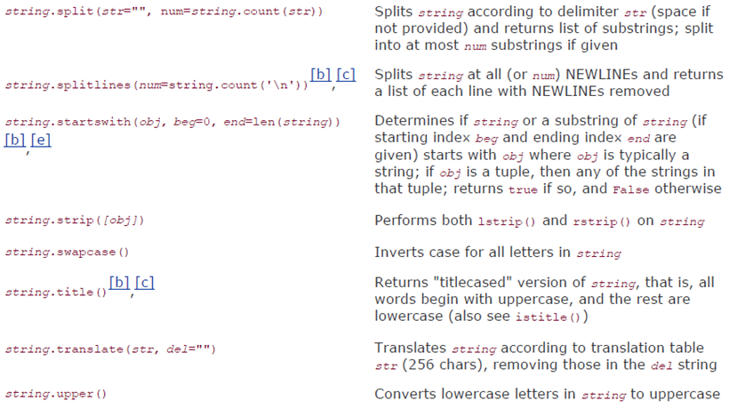
Built in Methods on Strings cont..

Slide 40
Sequence
A sequence is a datatype that represents a group of elements.
The purpose of any sequence is to store and process group elements.
In python, strings, lists, tuples and dictionaries are very important sequence datatypes.

Slide 41
List
A list is similar to an array that consists of a group of elements or items.
The Difference is …………….
An array can store only one type of elements whereas a list can store different types of elements.
To create a List as putting different comma-separated values between square brackets [ ].

Slide 42
List
Example:
Student=[556, "mothi", 84, 96, 84, 75, 84]
To Create empty List without any elements by simply writing empty square brackets as:
Student=[ ]

Slide 43
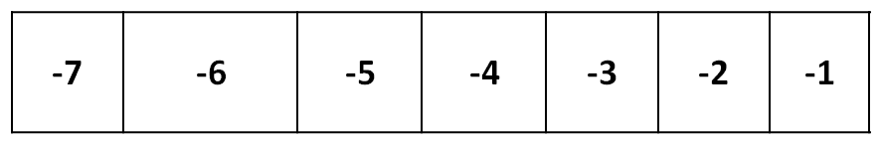
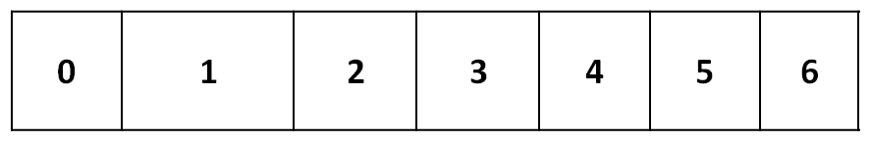
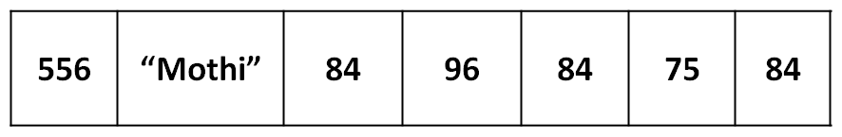
List
Accessing values in List:
use the square brackets for slicing along with the index or indices to obtain value available at that index.
negative Indexing
Positive Indexing
Student

Slide 44
List
Output:
[556, "Mothi", 84, 96, 84, 75, 84]
Mothi
[556, "MOTHI"]
[84, 96, 84, 75, 84]
[556, "MOTHI", 84]
[556, "MOTHI", 84, 96, 84, 75, 84]
84
[84, 75, 84, 96, 84, "MOTHI"]
Program:
student = [556, “Mothi”, 84, 96, 84, 75, 84 ]
print student
print student[0]
print student[0:2]
print student[2: ]
print student[ :3]
print student[ : ]
print student[-1]
print student[-1:-7:-1]

Slide 45
range() function
range() function used to print list of integer values.
Syntax:
range(start, end [, step])

Slide 46
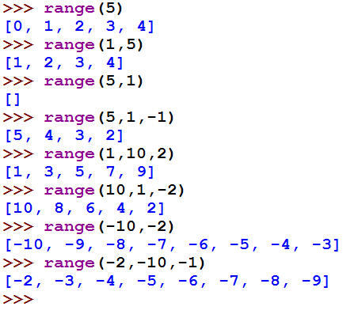
range() function
Example:

Slide 47
List
Creating List using range() function:
numbers=range(0,9)
print numbers #[0,1,2,3,4,5,6,7,8]
numbers=range(0,9,2)
print numbers #[0,2,4,6,8]

Slide 48
List
Looping over List:
numbers=[1,2,3,4,5]
for i in numbers:
print i,
Output:
1 2 3 4 5

Slide 49
List
Updating and Deleting List:
Lists are mutable.
It means we can modify the contents of a list.
We can append, update or delete the elements of a list depending upon our requirements.

Slide 50
List
Program:
a = [4, 7, 6, 8, 9]
print a
a[2] = 45
print a
a[2:5] = 10, 11, 12
print a
Output:
[4, 7, 6, 8, 9]
[4, 7, 45, 8, 9]
[4, 7, 10, 11, 12]

Slide 51
List
Program:
a = [4, 7, 6, 8, 9]
print a
del a[3]
print a
Output:
[4, 7, 6, 8, 9]
[4, 7, 6, 9]

Slide 52
List
Concatenation of Two lists
We can simply use ‘+’ operator on two lists to join them.
Program:
a = [4, 7, 6, 8, 9]
b = [1, 2, 3]
print a+b
Output:
[4, 7, 6, 8, 9, 1, 2, 3]

Slide 53
List
Repetition of Two lists
We can repeat the elements of a list ‘n’ number of times using ‘ * ’ operator.
Program:
a = [4, 7, 6, 8, 9]
print a*2
Output:
[4, 7, 6, 8, 4, 7, 6, 8]

Slide 54
List
Membership in lists
We can check if an element is a member of a list by using ‘in’ and ‘not in’ operator.
Program:
a = [4, 7, 6, 8, 9]
x = 7
print x in a
y = 10
print y not in a
Output:
True
True

Slide 55
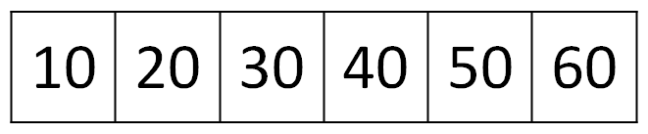
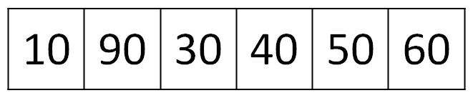
List
Aliasing lists
Giving a new name to an existing list is called ‘aliasing’.
To provide a new name to this list, we can simply use assignment operator (=).
X
y
Before Modifications
X
y
After Modifications

Slide 56
List
Program:
a = [10, 20, 30, 40, 50, 60]
x = a
print a
print x
a[1]= 90
print a
print x
Output:
[10, 20, 30, 40, 50, 60]
[10, 20, 30, 40, 50, 60]
[10, 90, 30, 40, 50, 60]
[10, 90, 30, 40, 50, 60]

Slide 57
List
Cloning lists
Obtaining exact copy of an existing object (or list) is called ‘cloning’.
To Clone a list, we can take help of the slicing operation [:].

Slide 58
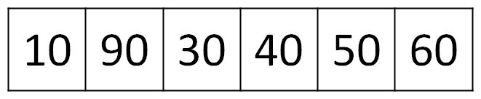
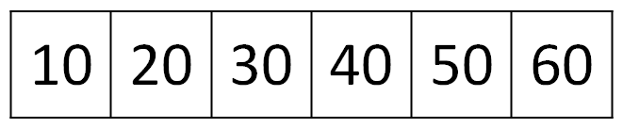
List
X
y
Before Modifications
X
y
After Modifications

Slide 59
List
Program:
a = [10, 20, 30, 40, 50, 60]
x = a[ : ]
print a
print x
a[1]= 90
print a
print x
Output:
[10, 20, 30, 40, 50, 60]
[10, 20, 30, 40, 50, 60]
[10, 90, 30, 40, 50, 60]
[10, 20, 30, 40, 50, 60]

Slide 60
List
Method | Description
lst.index(x) | Returns the first occurrence of x in the list.
lst.append(x) | Appends x at the end of the list.
lst.insert(i,x) | Inserts x to the list in the position specified by i.
lst.copy() | Copies all the list elements into a new list and returns it.
lst.extend(lst2) | Appends lst2 to list.
lst.count(x) | Returns number of occurrences of x in the list.
lst.remove(x) | Removes x from the list.
lst.pop() | Removes the ending element from the list.
lst.sort() | Sorts the elements of list into ascending order.
lst.reverse() | Reverses the sequence of elements in the list.
lst.clear() | Deletes all elements from the list.
max(lst) | Returns biggest element in the list.
min(lst) | Returns smallest element in the list.

Slide 61
List
Nested List:
A list within another list is called a nested list.
Program:
a = [[1, 2],[3,4],[5,6]]
print a[1]
print a[2][1]
for i in a[2]:
print i,
Output:
[1,2]
6
5 6

Slide 62
List
List Comprehensions:
List comprehensions represent creation of new lists from an iterable object that satisfy a given condition.
squares=[ ]
for i in range(1,11):
squares.append(i**2)
Can be rewritten as………..
squares=[x**2 for x in range(1,11)]

Slide 63
Tuple
A Tuple is a python sequence which stores a group of elements or items.
Tuples are similar to lists but the main difference is tuples are immutable whereas lists are mutable.
Once we create a tuple we cannot modify its elements.
Tuples are generally used to store data which should not be modified and retrieve that data on demand.

Slide 64
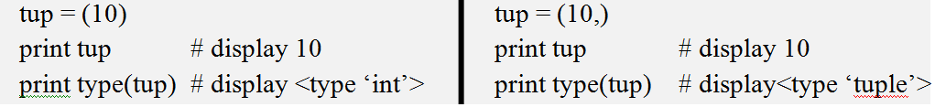
Tuple
Creating a tuple by writing elements separated by commas inside parentheses ( ).
tup = (10, 556, 22.3, “Mothi”)
To create a tuple with only one element, we can, mention that element in parenthesis and after that a comma is needed.

Slide 65
Tuple
Accessing values in Tuple:
Accessing the elements from a tuple can be done using indexing or slicing.
tup = (50,60,70,80,90)
print tup[0] # 50
print tup[1:4] # (60,70,80)
print tup[-1] # 90
print tup[-1:-4:-1] # (90,80,70)
print tup[-4:-1] # (60,70,80)

Slide 66
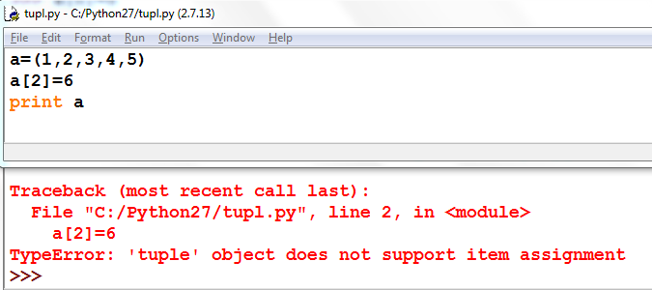
Tuple
Updating and deleting in Tuple:
Tuples are immutable which means you cannot update, change or delete the values of tuple elements.

Slide 67
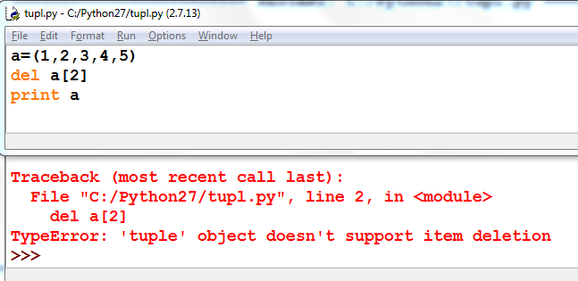
Tuple

Slide 68
Tuple
Operation | Description
len(t) | Return the length of tuple.
tup1+tup2 | Concatenation of two tuples.
tup*n | Repetition of tuple values in n number of times.
x in tup | Return True if x is found in tuple otherwise returns False.
cmp(tup1,tup2) | Compare elements of both tuples
max(tup) | Returns the maximum value in tuple.
min(tup) | Returns the minimum value in tuple.
tuple(list) | Convert list into tuple.
tup.count(x) | Returns how many times the element ‘x’ is found in tuple.
tup.index(x) | Returns the first occurrence of the element ‘x’ in tuple. Raises ValueError if ‘x’ is not found in the tuple.
sorted(tup) | Sorts the elements of tuple into ascending order. sorted(tup,reverse=True) will sort in reverse order.

Slide 69
Tuple
Nested Tuple:
A list within another list is called a nested list.
Program:
students=(("RAVI", "CSE", 92.00), ("RAMU", "ECE", 93.00),
("RAJA", "EEE", 87.00))
for i in students:
print i
Output:
("RAVI", "CSE", 92.00)
("RAMU", "ECE", 93.00)
("RAJA", "EEE", 87.00)

Slide 70
Set
Set is another data structure supported by python.
Basically, sets are same as lists but with a difference that sets are lists with no duplicate entries.
Technically a set is a mutable and an unordered collection of items. This means that we can easily add or remove items from it.

Slide 71
Set
Creating a set:
A set is created by placing all the elements inside curly brackets { }.
s={1, 2.5, "abc" }
print s
Output:
set([1, 2.5, "abc" ])

Slide 72
Set
Converting list into a set:
A set can have any number of items and they may be of different data types. set() function is used to converting list into set.
s=set([1, 2.5, "abc"])
print s
Output:
set([1, 2.5, "abc" ])

Slide 73
Set
Operation | Description
len(s) | number of elements in set s (cardinality)
s.issubset(t) (or) s <= t | test whether every element in s is in t
s.issuperset(t) (or) s >= t | test whether every element in t is in s
s.union(t) (or) s|t | new set with elements from both s and t
s.intersection(t) (or) s & t | new set with elements common to s and t
s.copy() | new set with a shallow copy of s
s.update(t) | return set s with elements added from t

Slide 74
Dictionary
A dictionary represents a group of elements arranged in the form of key-value pairs. The first element is considered as ‘key’ and the immediate next element is taken as its ‘value’.
The key and its value are separated by a colon (:). All the key-value pairs in a dictionary are inserted in curly braces { }.

Slide 75
Dictionary
Program:
d= { 'Regd.No': 556, 'Name':'Mothi', 'Branch': 'CSE' }
print d['Regd.No'] # 556
print d['Name'] # Mothi
print d['Branch'] # CSE

Slide 76
Dictionary
Program:
d={'Regd.No':556,'Name':'Mothi','Branch':'CSE'}
print d
d['Gender']="Male"
print d
Output:
{'Regd.No':556,'Name':'Mothi','Branch':'CSE'}
{'Gender': 'Male', 'Branch': 'CSE', 'Name': 'Mothi', 'Regd.No': 556}

Slide 77
Dictionary
Method | Description
d.clear() | Removes all key-value pairs from dictionary‘d’.
d2=d.copy() | Copies all elements from‘d’ into a new dictionary d2.
d.fromkeys(s [,v] ) | Create a new dictionary with keys from sequence‘s’ and values all set to ‘v’.
d.get(k [,v] ) | Returns the value associated with key ‘k’. If key is not found, it returns ‘v’.
d.items() | Returns an object that contains key-value pairs of‘d’. The pairs are stored as tuples in the object.
d.keys() | Returns a sequence of keys from the dictionary‘d’.
d.values() | Returns a sequence of values from the dictionary‘d’.
d.update(x) | Adds all elements from dictionary ‘x’ to‘d’.
d.pop(k [,v] ) | Removes the key ‘k’ and its value from‘d’ and returns the value. If key is not found, then the value ‘v’ is returned. If key is not found and ‘v’ is not mentioned then ‘KeyError’ is raised.
d.setdefault(k [,v] ) | If key ‘k’ is found, its value is returned. If key is not found, then the k, v pair is stored into the dictionary‘d’.

